Slide 1

MATH30
Probability and Statistics

Slide 2
The Bernoulli Process
An experiment often consists of repeated trials, each with two possible outcomes that may be labeled success or failure. The most obvious application deals with the testing of items as they come from an assembly line, where each test or trial may indicate a defective or a nondefective item. We may choose to define either outcome as a success. The process is referred to as a Bernoulli process. Each trial is called a Bernoulli trial.

Slide 3
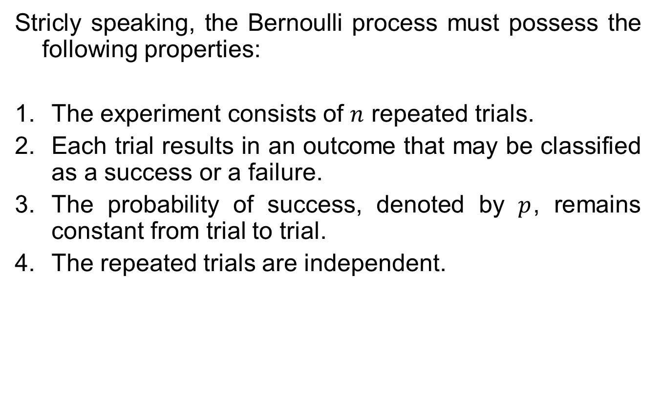
The Bernoulli Process
Stricly speaking, the Bernoulli process must possess the following properties:
The experiment consists of $n$ repeated trials.
Each trial results in an outcome that may be classified as a success or a failure.
The probability of success, denoted by $p$, remains constant from trial to trial.
The repeated trials are independent.

Slide 4
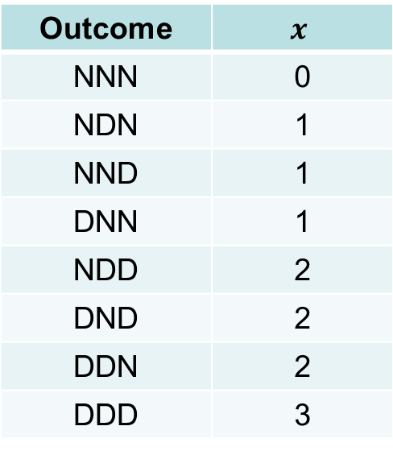

The Bernoulli Process
Example:
Consider the set of Bernoulli’s trial where three items are selected at random from a manufacturing process, inspected, and classified defective or nondefective. A defective item is designated a success. The number of successes is a random variable X assuming integral values from zero to 3. The eight possible outcomes and the corresponding values of $X$ are
Outcome | $$x$$
NNN | 0
NDN | 1
NND | 1
DNN | 1
NDD | 2
DND | 2
DDN | 2
DDD | 3

Slide 5
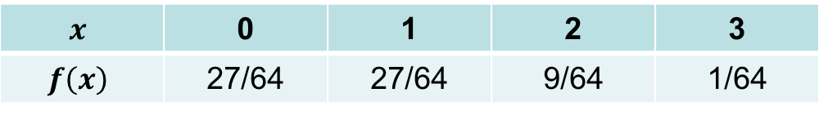
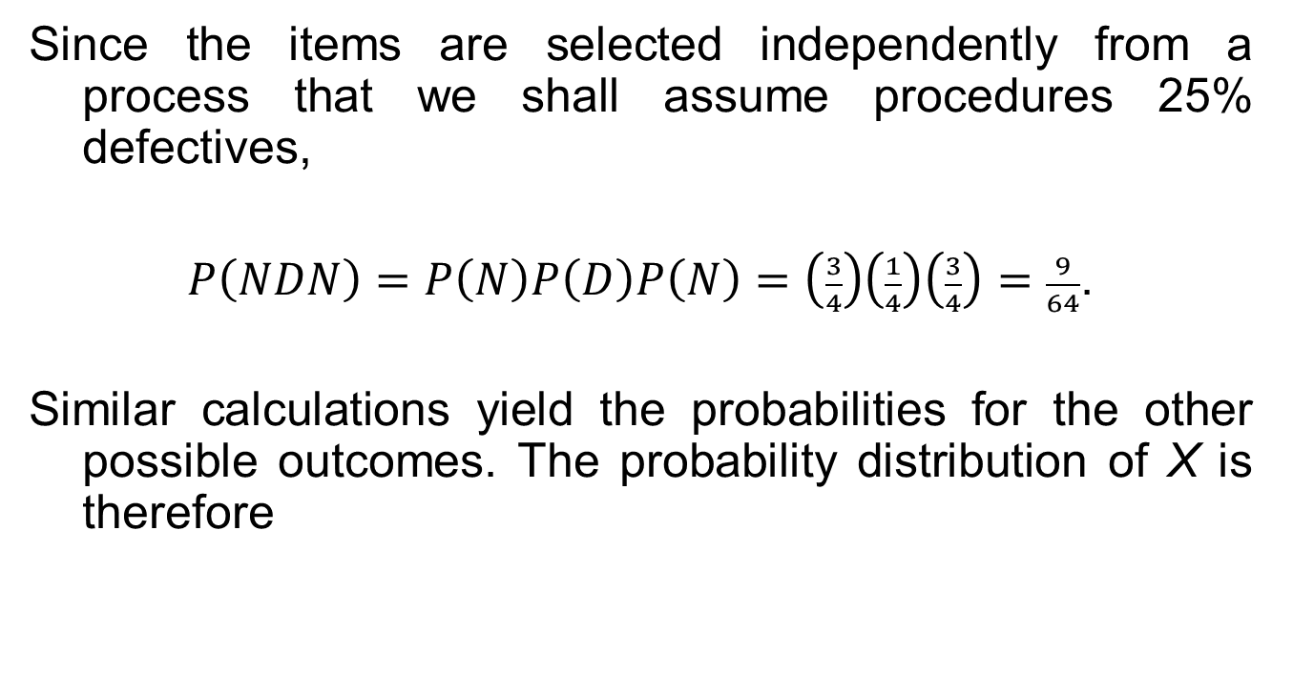
The Bernoulli Process
Since the items are selected independently from a process that we shall assume procedures 25% defectives,
$P\left(NDN\right)=P\left(N\right)P\left(D\right)P\left(N\right)=\left(\frac{3}{4}\right)\left(\frac{1}{4}\right)\left(\frac{3}{4}\right)=\frac{9}{64}$.
Similar calculations yield the probabilities for the other possible outcomes. The probability distribution of X is therefore
$$x$$ | 0 | 1 | 2 | 3
$$f\left(x\right)$$ | 27/64 | 27/64 | 9/64 | 1/64

Slide 6
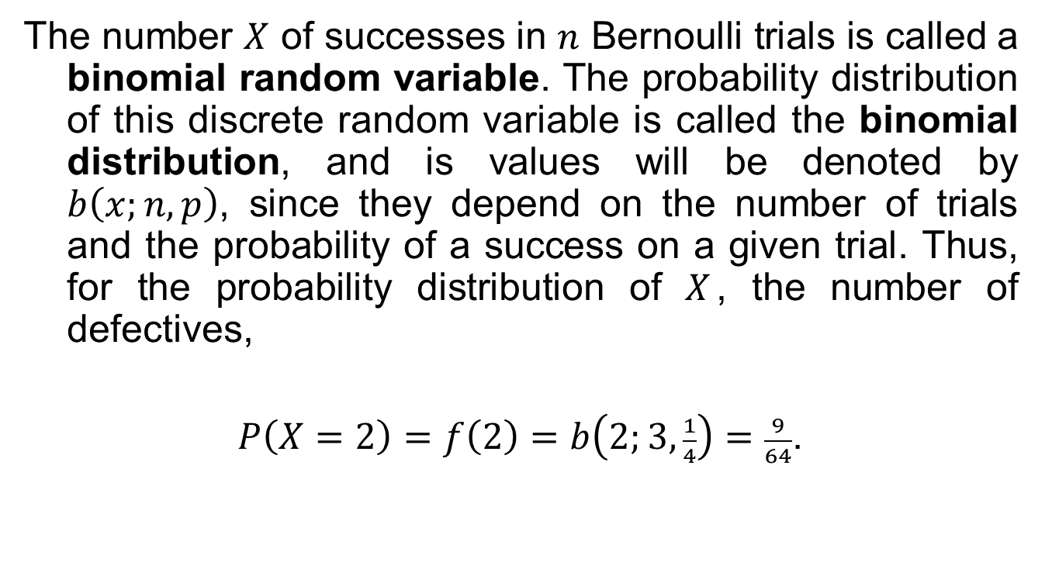
Binomial Distribution
The number $X$ of successes in $n$ Bernoulli trials is called a binomial random variable. The probability distribution of this discrete random variable is called the binomial distribution, and is values will be denoted by $b\left(x;n, p\right)$, since they depend on the number of trials and the probability of a success on a given trial. Thus, for the probability distribution of $X$, the number of defectives,
$P\left(X=2\right)=f\left(2\right)=b\left(2;3, \frac{1}{4}\right)=\frac{9}{64}$.

Slide 7
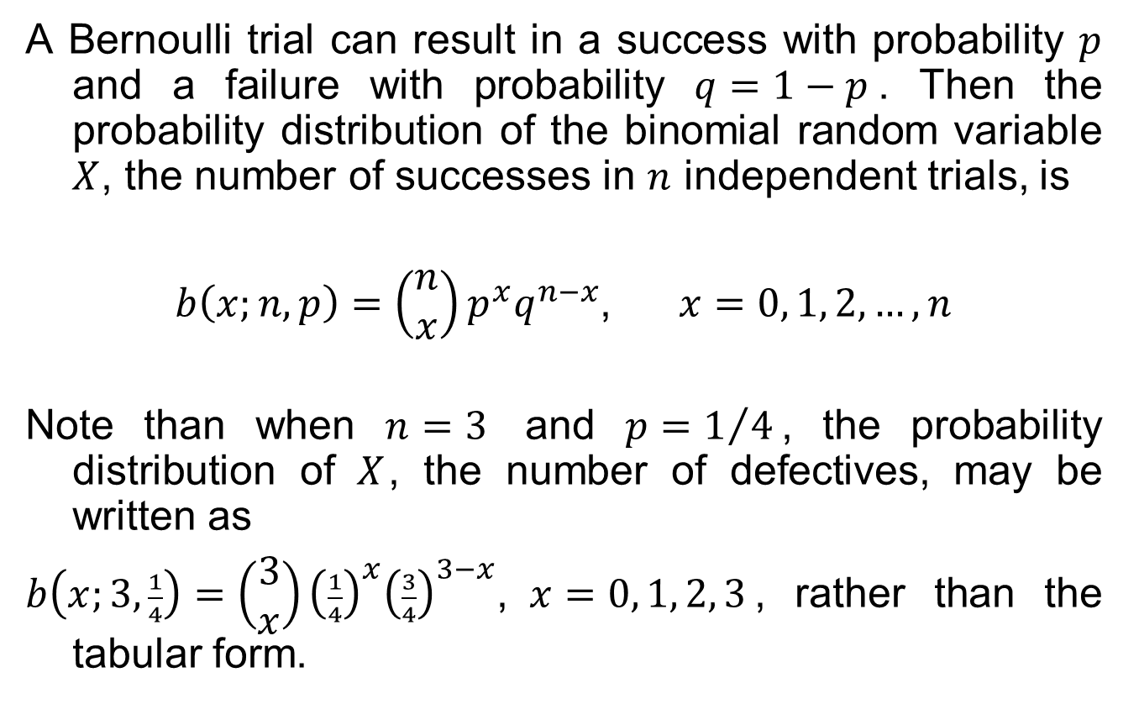
Binomial Distribution
A Bernoulli trial can result in a success with probability $p$ and a failure with probability $q=1−p$. Then the probability distribution of the binomial random variable $X$, the number of successes in $n$ independent trials, is
$b\left(x;n, p\right)=\left(\begin{matrix}n \\ x\end{matrix}\right)p^{x}q^{n−x}$, $x=0, 1, 2,…, n$
Note than when $n=3$ and $p=1/4$, the probability distribution of $X$, the number of defectives, may be written as
$b\left(x;3, \frac{1}{4}\right)=\left(\begin{matrix}3 \\ x\end{matrix}\right){\left(\frac{1}{4}\right)}^{x}{\left(\frac{3}{4}\right)}^{3−x}$, $x=0, 1, 2, 3$, rather than the tabular form.

Slide 8
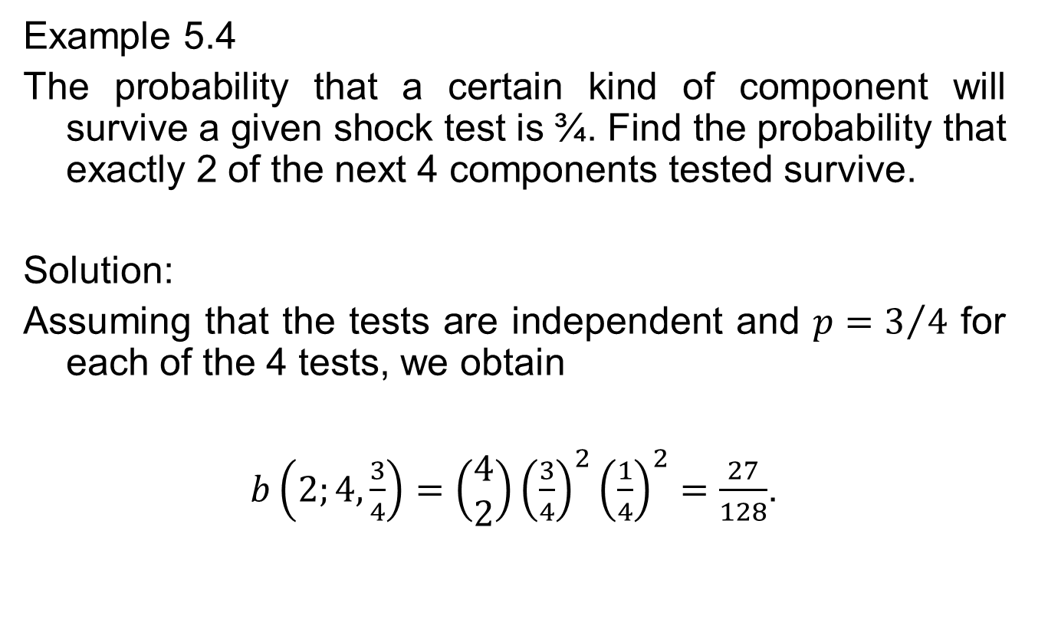
Binomial Distribution
Example 5.4
The probability that a certain kind of component will survive a given shock test is ¾. Find the probability that exactly 2 of the next 4 components tested survive.
Solution:
Assuming that the tests are independent and $p=3/4$ for each of the 4 tests, we obtain
$b\left(2;4, \frac{3}{4}\right)=\left(\begin{matrix}4 \\ 2\end{matrix}\right){\left(\frac{3}{4}\right)}^{2}{\left(\frac{1}{4}\right)}^{2}=\frac{27}{128}$.

Slide 9
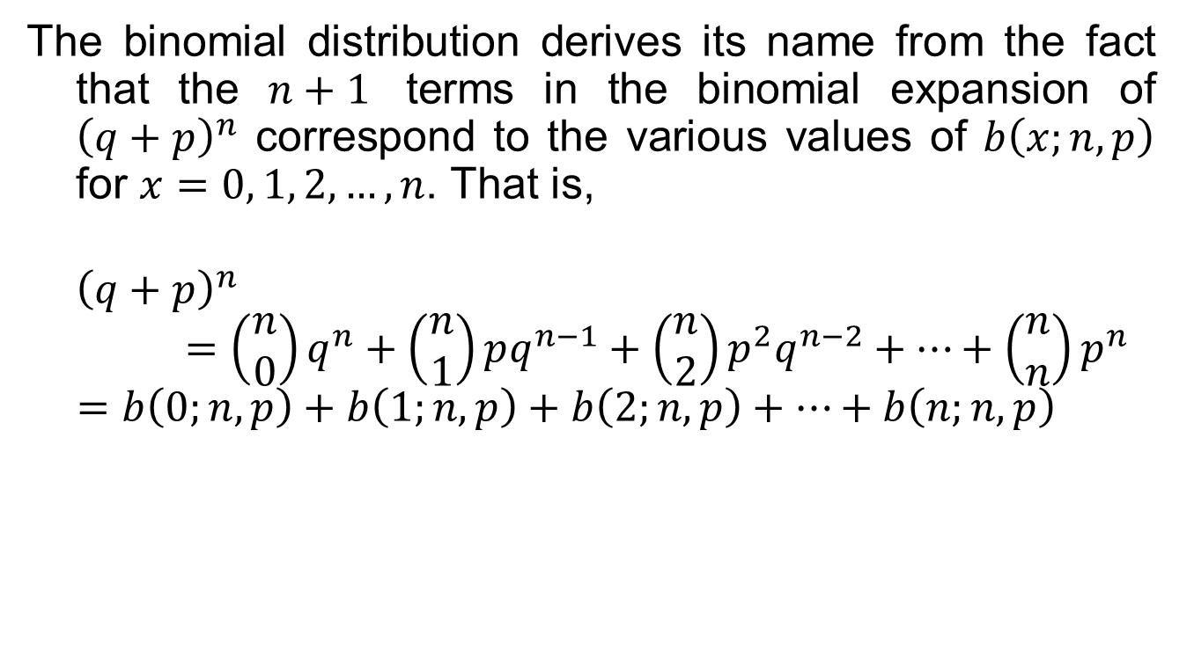
Where Does the Name Binomial Come From?
The binomial distribution derives its name from the fact that the $n+1$ terms in the binomial expansion of ${\left(q+p\right)}^{n}$ correspond to the various values of $b\left(x;n, p\right)$ for $x=0, 1, 2,…,n$. That is,
$${\left(q+p\right)}^{n}=\left(\begin{matrix}n \\ 0\end{matrix}\right)q^{n}+\left(\begin{matrix}n \\ 1\end{matrix}\right)pq^{n−1}+\left(\begin{matrix}n \\ 2\end{matrix}\right)p^{2}q^{n−2}+…+\left(\begin{matrix}n \\ n\end{matrix}\right)p^{n}$$
$$=b\left(0;n, p\right)+b\left(1;n, p\right)+b\left(2;n, p\right)+…+b\left(n;n, p\right)$$

Slide 10
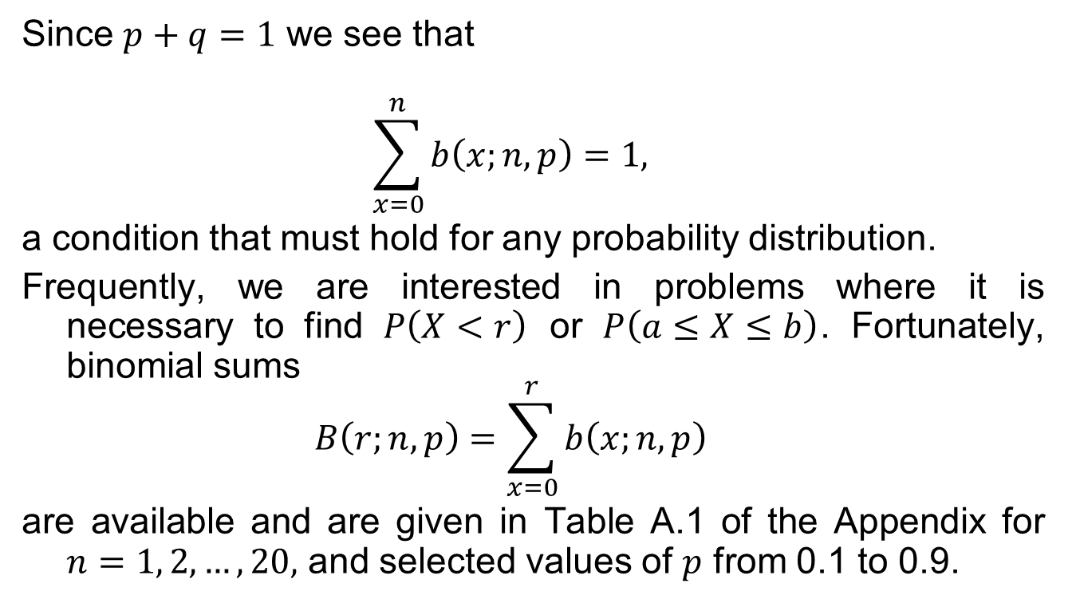
Where Does the Name Binomial Come From?
Since $p+q=1$ we see that
$$\sum_{x=0}^{n}{b\left(x;n, p\right)}=1,$$
a condition that must hold for any probability distribution.
Frequently, we are interested in problems where it is necessary to find $P\left(X<r\right)$ or $P\left(a≤X≤b\right)$. Fortunately, binomial sums
$$B\left(r;n, p\right)=\sum_{x=0}^{r}{b\left(x;n, p\right)}$$
are available and are given in Table A.1 of the Appendix for $n=1, 2,…, 20,$ and selected values of $p$ from 0.1 to 0.9.

Slide 11
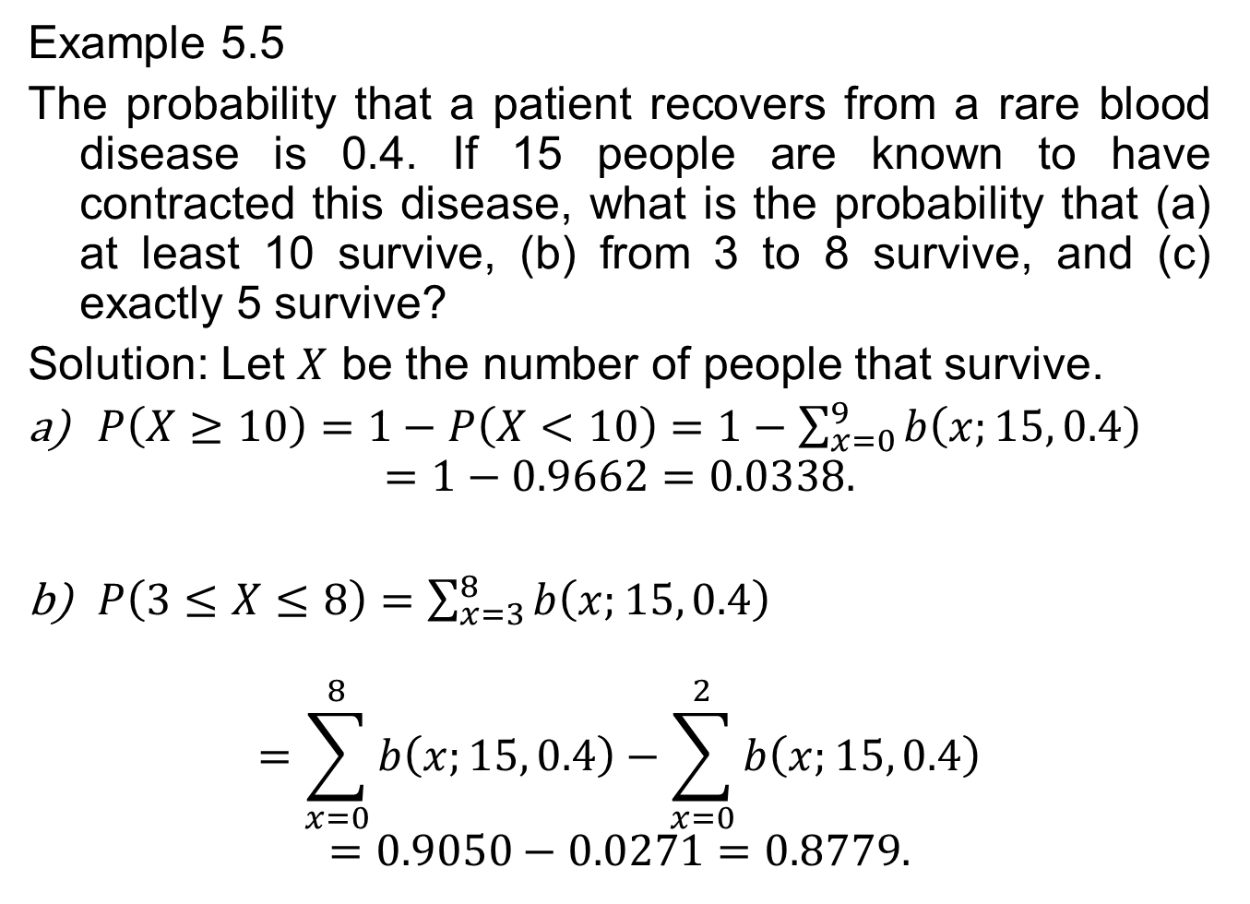
Binomial Distribution
Example 5.5
The probability that a patient recovers from a rare blood disease is 0.4. If 15 people are known to have contracted this disease, what is the probability that (a) at least 10 survive, (b) from 3 to 8 survive, and (c) exactly 5 survive?
Solution: Let $X$ be the number of people that survive.
$P\left(X≥10\right)=1−P\left(X<10\right)=1−\sum_{x=0}^{9}{b\left(x;15, 0.4\right)}$
$$=1−0.9662=0.0338.$$
$P\left(3≤X≤8\right)=\sum_{x=3}^{8}{b\left(x;15, 0.4\right)}$
$$=\sum_{x=0}^{8}{b\left(x;15, 0.4\right)}−\sum_{x=0}^{2}{b\left(x;15, 0.4\right)}$$
$$=0.9050−0.0271=0.8779.$$

Slide 12

Binomial Distribution
$P\left(X=5\right)=b\left(5;15, 0.4\right)=\sum_{x=0}^{5}{b\left(x;15, 0.4\right)}−\sum_{x=0}^{4}{b\left(x;15, 0.4\right)}$
$$=0.4032−0.2173=0.1859.$$

Slide 13
Binomial Distribution
Example 5.6
A large chain retailer purchases a certain kind of electronic device from a manufacturer. The manufacturer indicates that the defective rate of the device is 3%.
The inspector of the retailer randomly picks 20 items from a shipment. What is the probability that there will be at least one defective item among these 20?
Suppose that the retailer receives 10 shipments in a month and the inspector randomly tests 20 devices per shipment. What is the probability that there will be 3 shipments containing at least one defective device?

Slide 14
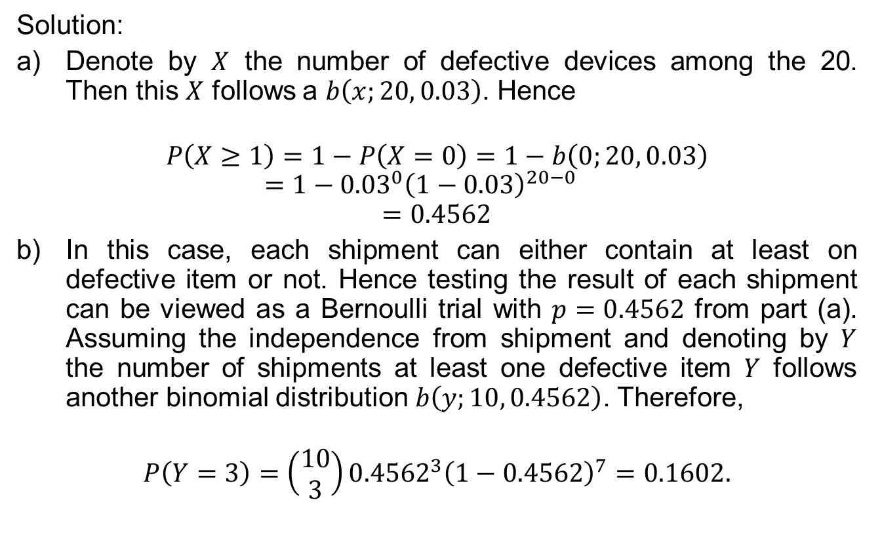
Binomial Distribution
Solution:
Denote by $X$ the number of defective devices among the 20. Then this $X$ follows a $b\left(x;20, 0.03\right)$. Hence
$$P\left(X≥1\right)=1−P\left(X=0\right)=1−b\left(0;20, 0.03\right)=1−{0.03}^{0}{\left(1−0.03\right)}^{20−0}$$
$$=0.4562$$
In this case, each shipment can either contain at least on defective item or not. Hence testing the result of each shipment can be viewed as a Bernoulli trial with $p=0.4562$ from part (a). Assuming the independence from shipment and denoting by $Y$ the number of shipments at least one defective item $Y$ follows another binomial distribution $b\left(y;10, 0.4562\right)$. Therefore,
$$P\left(Y=3\right)=\left(\begin{matrix}10 \\ 3\end{matrix}\right){0.4562}^{3}{\left(1−0.4562\right)}^{7}=0.1602.$$

Slide 15

Binomial Distribution
Theorem 5.2
The mean and variance of the binomial distribution $b\left(x;n, p\right)$ are
$μ=np$ and $σ^{2}=npq$.

Slide 16
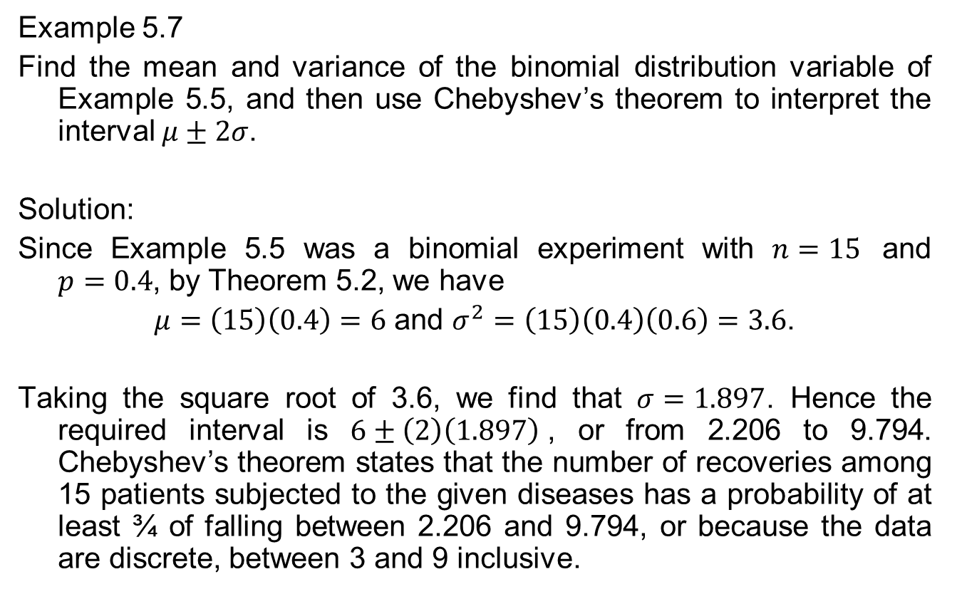
Binomial Distribution
Example 5.7
Find the mean and variance of the binomial distribution variable of Example 5.5, and then use Chebyshev’s theorem to interpret the interval $μ±2σ$.
Solution:
Since Example 5.5 was a binomial experiment with $n=15$ and $p=0.4$, by Theorem 5.2, we have
$μ=\left(15\right)\left(0.4\right)=6$ and $σ^{2}=\left(15\right)\left(0.4\right)\left(0.6\right)=3.6$.
Taking the square root of 3.6, we find that $σ=1.897$. Hence the required interval is $6±\left(2\right)\left(1.897\right)$, or from 2.206 to 9.794. Chebyshev’s theorem states that the number of recoveries among 15 patients subjected to the given diseases has a probability of at least ¾ of falling between 2.206 and 9.794, or because the data are discrete, between 3 and 9 inclusive.

Slide 17
Binomial Distribution
Example 5.8
It is conjectured that an impurity exists in 30% of all drinking wells in a certain rural community. In order to gain some insight on this problem, it is determined that some tests should be made. It is too expensive to test all of the many wells in this area so 10 were randomly selected for testing.
Using the binomial distribution what is the probability that exactly three wells have the impurity assuming that the conjecture is correct?
What is the probability that more than three wells are impure?

Slide 18
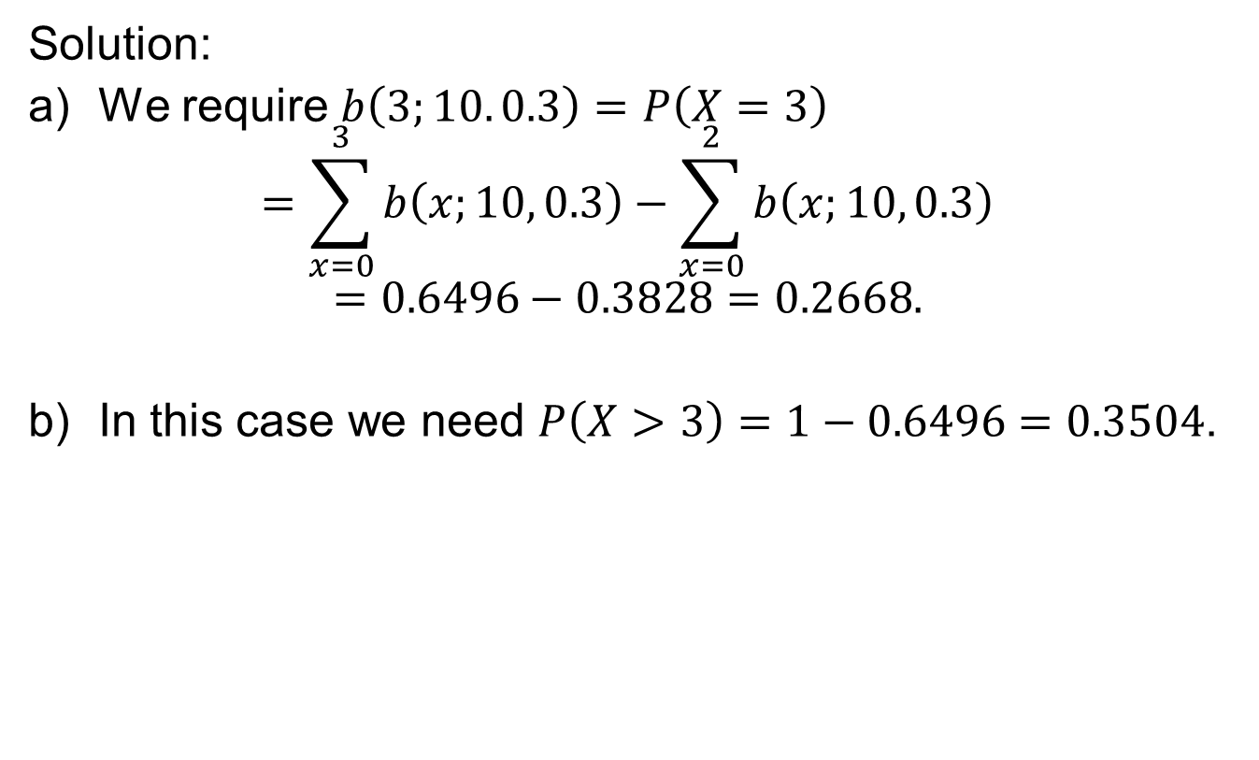
Binomial Distribution
Solution:
We require $b\left(3;10. 0.3\right)=P\left(X=3\right)$
$$=\sum_{x=0}^{3}{b\left(x;10, 0.3\right)}−\sum_{x=0}^{2}{b\left(x;10, 0.3\right)}$$
$$=0.6496−0.3828=0.2668.$$
In this case we need $P\left(X>3\right)=1−0.6496=0.3504$.

Slide 19
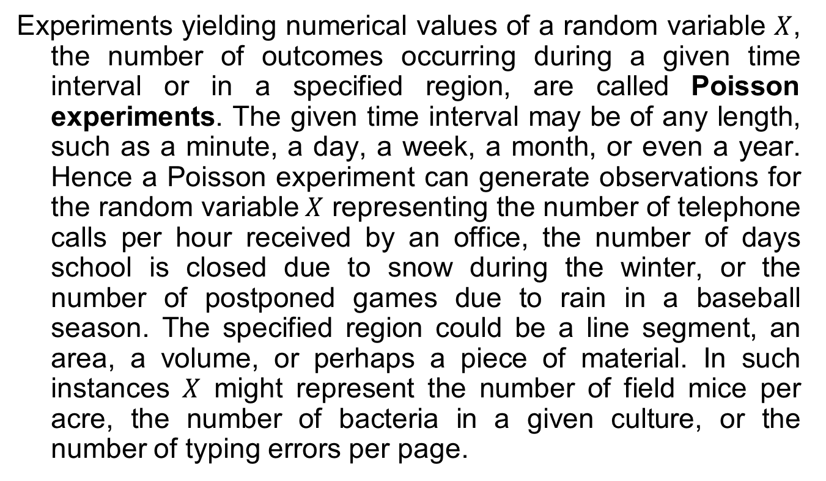
Poisson Distribution and the Poisson Process
Experiments yielding numerical values of a random variable $X$, the number of outcomes occurring during a given time interval or in a specified region, are called Poisson experiments. The given time interval may be of any length, such as a minute, a day, a week, a month, or even a year. Hence a Poisson experiment can generate observations for the random variable$X$ representing the number of telephone calls per hour received by an office, the number of days school is closed due to snow during the winter, or the number of postponed games due to rain in a baseball season. The specified region could be a line segment, an area, a volume, or perhaps a piece of material. In such instances $X$ might represent the number of field mice per acre, the number of bacteria in a given culture, or the number of typing errors per page.

Slide 20
Poisson Process
A Poisson experiment is derived from the Poisson process and possesses the following properties:
The number of outcomes occurring in one time interval or specified region is independent of the number that occurs in any other disjoint time interval or region of space. In this way we say that the Poisson process has no memory.
The probability that a single outcome will occur during a very short time interval or in a small region is proportional to the length of the time interval or the size of the region and does not depend on the number of outcomes occurring outside this time interval or region.
The probability that more than one outcome will occur in such a short time interval or fall in such a small region is negligible.

Slide 21
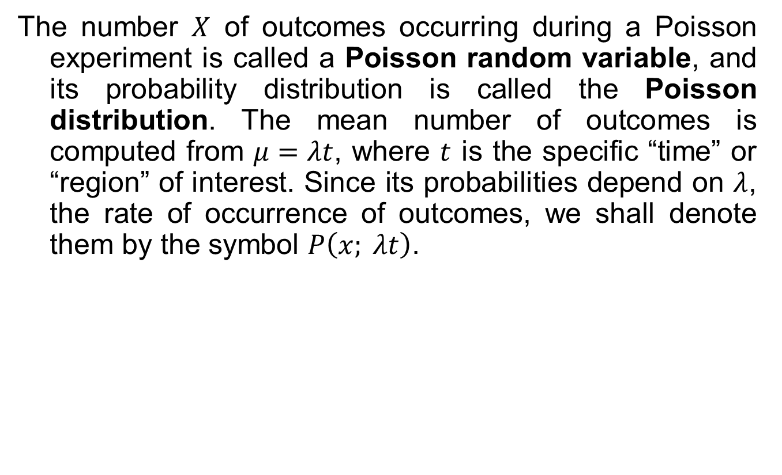
Poisson Process
The number $X$ of outcomes occurring during a Poisson experiment is called a Poisson random variable, and its probability distribution is called the Poisson distribution. The mean number of outcomes is computed from $μ=λt$, where $t$ is the specific “time” or “region” of interest. Since its probabilities depend on $λ$, the rate of occurrence of outcomes, we shall denote them by the symbol $P\left(x; λt\right)$.

Slide 22
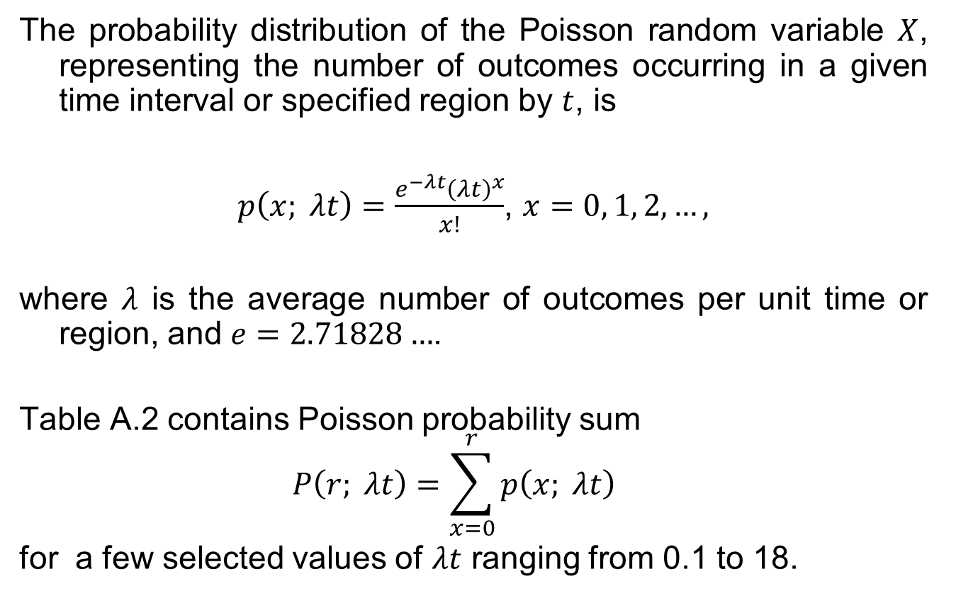
Poisson Distribution
The probability distribution of the Poisson random variable $X$, representing the number of outcomes occurring in a given time interval or specified region by $t$, is
$p\left(x; λt\right)=\frac{e^{−λt}{\left(λt\right)}^{x}}{x!}$, $x=0, 1, 2,…,$
where $λ$ is the average number of outcomes per unit time or region, and $e=2.71828…$.
Table A.2 contains Poisson probability sum
$$P\left(r; λt\right)=\sum_{x=0}^{r}{p\left(x; λt\right)}$$
for a few selected values of $λt$ ranging from 0.1 to 18.

Slide 23
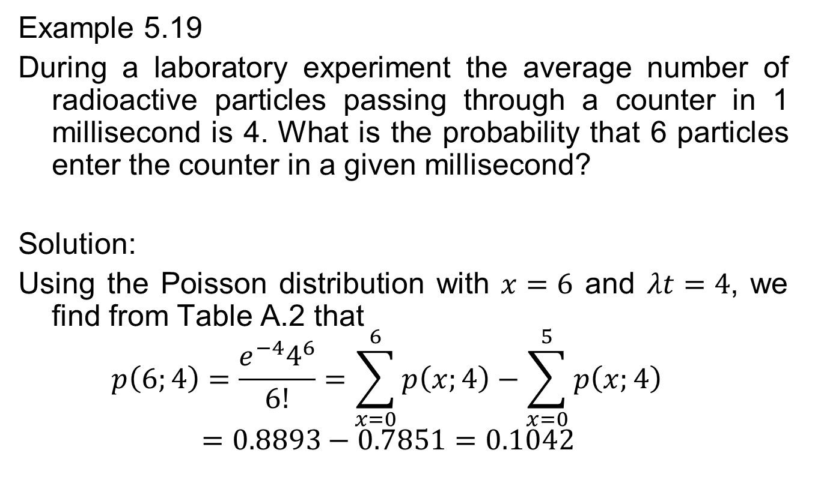
Poisson distribution
Example 5.19
During a laboratory experiment the average number of radioactive particles passing through a counter in 1 millisecond is 4. What is the probability that 6 particles enter the counter in a given millisecond?
Solution:
Using the Poisson distribution with $x=6$ and $λt=4$, we find from Table A.2 that
$$p\left(6;4\right)=\frac{e^{−4}4^{6}}{6!}=\sum_{x=0}^{6}{p\left(x;4\right)}−\sum_{x=0}^{5}{p\left(x;4\right)}=0.8893−0.7851=0.1042$$

Slide 24
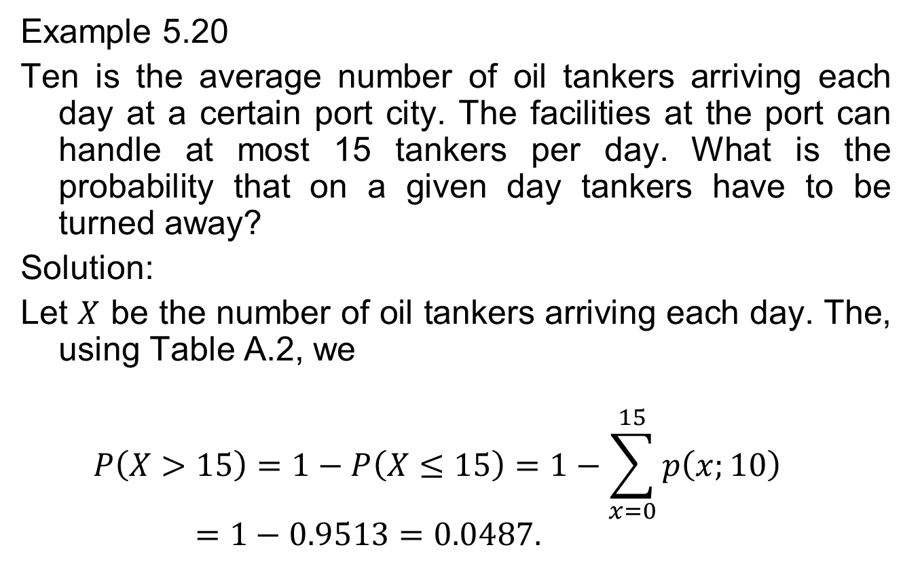
Poisson Distribution
Example 5.20
Ten is the average number of oil tankers arriving each day at a certain port city. The facilities at the port can handle at most 15 tankers per day. What is the probability that on a given day tankers have to be turned away?
Solution:
Let $X$ be the number of oil tankers arriving each day. The, using Table A.2, we
$$P\left(X>15\right)=1−P\left(X≤15\right)=1−\sum_{x=0}^{15}{p\left(x;10\right)}=1−0.9513=0.0487.$$

Slide 25
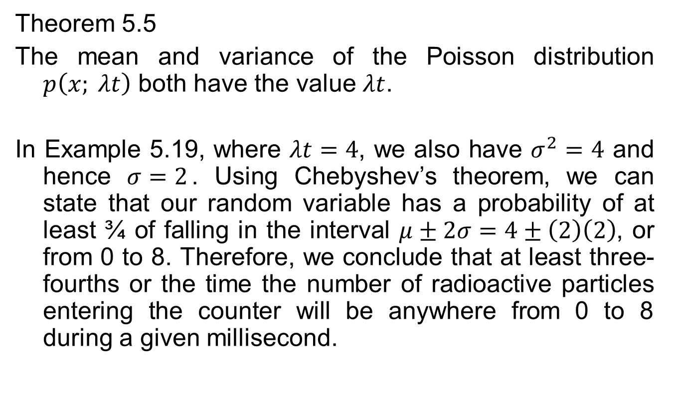
Poisson Distribution
Theorem 5.5
The mean and variance of the Poisson distribution $p\left(x; λt\right)$ both have the value $λt$.
In Example 5.19, where $λt=4$, we also have $σ^{2}=4$ and hence $σ=2$. Using Chebyshev’s theorem, we can state that our random variable has a probability of at least ¾ of falling in the interval $μ±2σ=4±\left(2\right)\left(2\right)$, or from 0 to 8. Therefore, we conclude that at least three-fourths or the time the number of radioactive particles entering the counter will be anywhere from 0 to 8 during a given millisecond.

Slide 26

The Poisson Distribution as a Limiting Form of the Binomial
Theorem 5.6
Let $X$ be a binomial random variable with probability distribution $b\left(x;n, p\right)$. When $n→∞$, $p→0$, and $μ=np$ remains constant.

Slide 27
The Poisson Distribution as a Limiting Form of the Binomial
Example 5.21
In a certain industrial facility accidents occur frequently. It is known that the probability of an accident on any given day is 0.005 and accidents are independent of each other.
What is the probability that in any given period of 400 days there will be an accident of one day?
What is the probability that there are at most three days with an accident?

Slide 28
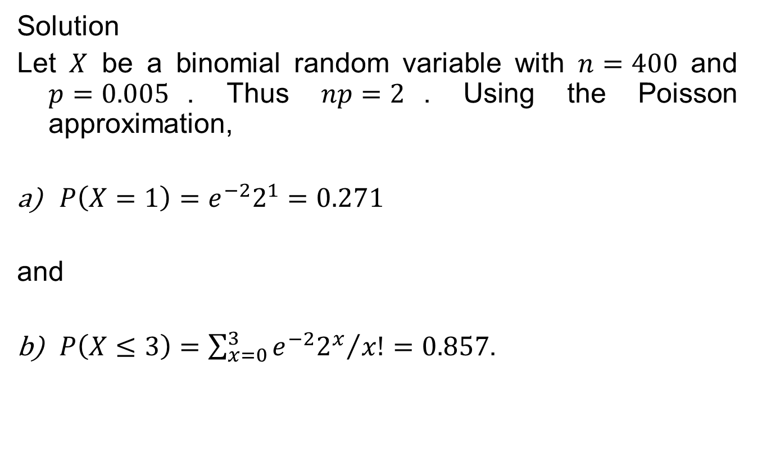
The Poisson Distribution as a Limiting Form of the Binomial
Solution
Let $X$ be a binomial random variable with $n=400$ and $p=0.005$. Thus $np=2$. Using the Poisson approximation,
$P\left(X=1\right)=e^{−2}2^{1}=0.271$
and
$P\left(X≤3\right)=\sum_{x=0}^{3}{{e^{−2}2^{x}}/{x!}}=0.857$.

Slide 29
The Poisson Distribution as a Limiting Form of the Binomial
Example 5.22
In a manufacturing process where glass products are produced, defects or bubbles occur, occasionally rendering the piece undesirable for marketing. It is known that, on average, 1 in every 1000 of these items produced has one or more bubbles. What is the probability that a random sample of 8000 will yield fewer than 7 items possessing bubbles?

Slide 30
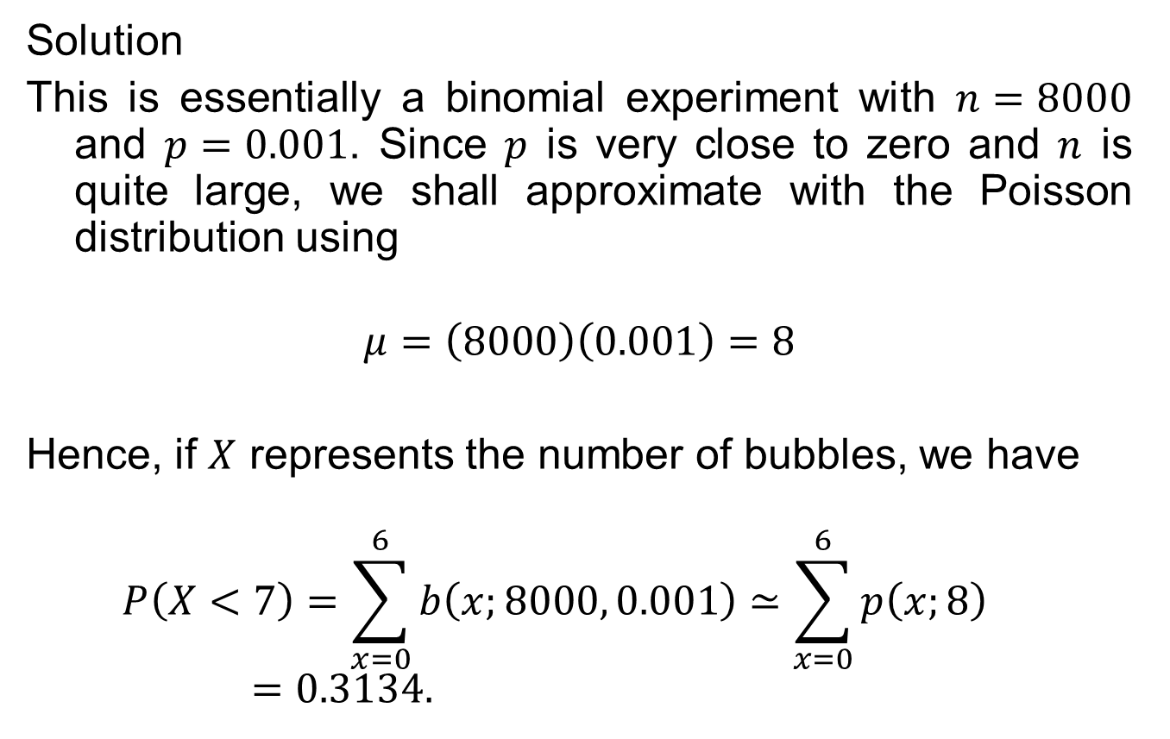
The Poisson Distribution as a Limiting Form of the Binomial
Solution
This is essentially a binomial experiment with $n=8000$ and $p=0.001$. Since $p$ is very close to zero and $n$ is quite large, we shall approximate with the Poisson distribution using
$$μ=\left(8000\right)\left(0.001\right)=8$$
Hence, if $X$ represents the number of bubbles, we have
$$P\left(X<7\right)=\sum_{x=0}^{6}{b\left(x;8000, 0.001\right)}≃\sum_{x=0}^{6}{p\left(x;8\right)}=0.3134.$$

